Slide 1


GOING GREEN
Alternative Certifications
Tbilisi, Georgia
June, 2021

Slide 2

1

Slide 3
In line with ongoing sustainability activism and the leading role that real estate can play contributing to environmental conservation, we are offering a series of articles, in which we will be reviewing the importance of greener orientation and sustainability in Real Estate, green buildings, sustainable materials and practices, financial benefits of eco-friendly buildings, and lastly we will be touching upon greenness trends in Georgia to assess where real estate stands in the country on the road to sustainability.
In our previous articles we explained the importance of sustainability and green buildings, and introduced LEED system. We explained how to get LEED certificate, and reviewed its assessment areas and sustainable building materials. We also showed LEED from investors’ perspective - financial gains associated with it and other monetary impetus for going green. We also introduced energy efficient, ecological, affordable, and comfortable construction concept - Passive House, its guiding principles and advantages.
In this article we will briefly explain 3 widely-accepted and highly popular third-party certifications, besides LEED and Passive House Standard, that validate green features of green buildings. Specifically, we will touch upon the working principles and advantages of BREEAM, Energy Star and Energy Performance Certification systems, and present relevant case studies.
The series is published every week and can be found at:
www.cushwake.ge
2

Slide 4

BREEAM
BREEAM - Building Research Establishment Environmental Assessment Methodology - is a globally accepted program that indicates a building was designed and constructed to a certain level of environmental responsibility. This methodology is widely approved in the UK, and notably, represents the oldest method of assessing, rating and certifying a building’s environmental sustainability. Globally, there are over 540,000 buildings with BREEAM certificate and more than two million registered for assessment.
In order to award a certification to a building, BREEAM incorporates licensed assessors who examine whether the building meets the credit criteria or not; if the building fulfills its requirements, BREEAM accreditation is issued.
To get BREEAM certification, projects are assessed on the basis of several categories, which address the factors influencing conservation of environment, such as carbon emissions reduction, low impact and durable design, resilience, adaptation to climate, protecting biodiversity. Each category, listed below, has individual weightings differing by project type:
Management (adoption of sustainable management practices)
Health and well-being (comfort, health and safety of occupants)
Energy (sustainable use of energy)
Transport (accessibility of public transport)
Water (sustainable water use, reduced water consumption)
Materials (reduced impact of construction materials)
Waste (improved waste management, reduced & reused construction waste)
Land use and ecology (sustainable land use, habitat protection)
Pollution (control pollution, reduced surface water run-off)
Innovation (reward exemplary performance, which go beyond required criteria)
3

Slide 5
Based on acquired credits in each category, the corresponding certificate will be issued.
Rating
Level
Percentage
Score
Outstanding
≥85%
Excellent
≥70%
Very Good
≥55%
Good
≥45%
Pass
≥30%
Unclassified
<30%
BREEAM pushes the boundaries of sustainability by aiming for zero carbon footprint. The data shows that the average CO2 reduction for a BREEAM assessed building is 22%, while a building with BREEAM Excellent certificate is expected to be as high as 33%.
Certification demonstrates sustainability of a property, while helping to lower running costs, increase returns through market value and attract and retain tenants by offering desirable places to live and work.
4

Slide 6
Costs and Gains
Making changes to a building to meet BREEAM requirements will incur some additional costs. For example, acquiring BREEAM certification, ranging from a ‘Pass’ to an ‘Excellent’ rating, incurs an increase in capital cost from 0% to 1.71% for office and school buildings, and up to 5.51% for a healthcare building. Based on various research conducted by Soulti and Leonard (2016), the cost uplift for different types of buildings changes in line with different levels of BREEAM certification.
RATING
SCHOOL
INDUSTRIAL
RETAIL
OFFICE
MIXED USE
Very Good
0.2%
0.1%
0.2%
0.2%
0.15%
Excellent
0.7%
0.4%
1.8%
0.8%
1.5%
Outstanding
5.8%
4.8%
10.1%
9.8%
4.8%

Slide 7
However, it is noteworthy that the savings in operational costs for BREEAM buildings may lead to a 2–5-year payback. Additionally, World Green Building Council reports some significant material and non-material gains of BREEAM certification, such as:
THE DEVELOPER’S
PERSPECTIVE:
THE OWNER’S
PERSPECTIVE:
THE TENANT’S
PERSPECTIVE:
The sale prices increased by up to 30%
The rental rates for buildings increased by up to 24.9%
Operational costs reduced by 11%
Building value increased by 38%
Working atmosphere/ comfort and convenience improved by 5%
Reputation increased by 18%
Energy costs reduced by 15%.
To sum up, BREEAM is said to allow developers, owners and tenants “to differentiate themselves in a competitive market with a highly visible, authoritative and internationally recognized quality mark”. In general, BREEAM helps clients to measure and reduce the impacts of their buildings, cut operational costs and increase value of their properties, benefiting both the environment and the society.
6

Slide 8
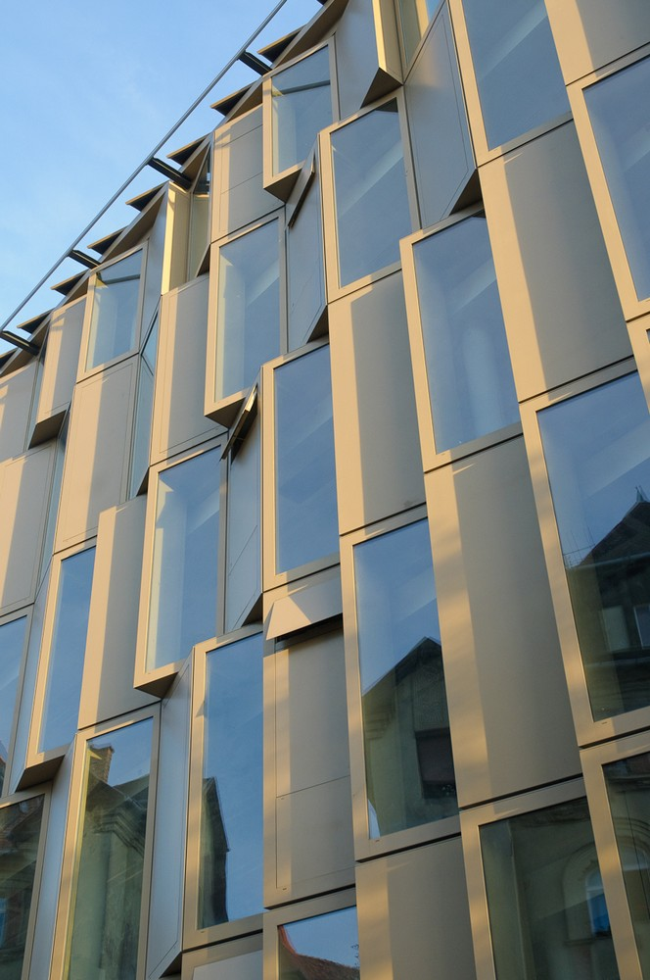
CASE STUDY 1
Name: Krisztina Palace
Location: Budapest, Hungary

Slide 9
Krisztina Palace is the office building built in 2010. It has a 15,745 m² office space, and 399 underground parking spots.
Initially the BREEAM certification was targeted to enhance the reputation of the building and to make it more attractive for prospective tenants. Notably, the office structure has unique architectural design, natural stone facades, while offices are filled with natural light and are equipped with suspended acoustical ceiling.
The building got high scores in several criteria, namely in Transport, due to excellent transport links to the location – railway station, trams and bus stops; scores were gained in Pollution and Waste category too, as the building employs environmentally friendly waste disposal methods, waste compactor and collection of recyclable wastes.
The owners are also working on using groundwater or rainwater as alternative sources of water for irrigation, and other renewable energy sources for energy demand.
Krisztina Palace collected 56 points and was rewarded with BREEAM certificate falling in rating level – “Very Good”.
8

Slide 10


Slide 11
Energy Star
Energy use plays an important role in determining overall sustainability of properties. Therefore, certificates that measure the energy efficiency of buildings are of significant importance. One such certificate is Energy Star.
Energy Star was developed in 1992 by the Department of Energy and Environmental Protection Agency (EPA) in the US. It is a voluntary public-private partnership program. Since its creation, the program has been adopted in numerous countries such as Canada, the European Union, Australia, Taiwan, Japan, and New Zealand. It is noteworthy that many commercial properties waste about 1/3 of the energy they consume; so the organization’s certification mostly focuses on an efficient use of energy in buildings.
For certification a building will need to earn an Energy Star score of 75 or higher out of 100, indicating that it performs better than at least 75% of similar buildings nationwide. Energy Star score assesses how the building is performing as a whole, also considering its physical attributes, and how the people inside are using them. Specifically, it uses an online benchmarking system, where building owners enter data about their buildings’ energy consumption, operation, number of occupants, location, and other characteristics, after which the system compares each building’s energy performance with the performance of similar buildings within the country. Moreover, the building must follow industry standards for thermal comfort, air ventilation, indoor air quality and illumination. Energy Star rates devices that are installed at homes and in enterprises, and certifies the energy efficient ones. For example, this can be high-efficiency HVAC systems that directly translate into savings in energy costs. HVAC systems are continuously improving and are always becoming more efficient. High-efficiency HVAC systems should make the top of the list of investments in a project and get Energy Star accreditation.
Having Energy Star accreditation in turn proves company’s sustainable approach to building and design, and differentiates a company from competitors. Noteworthily, the certification is given on an annual basis, so a building must maintain its high performance to be certified year to year. This in itself can help owners to determine whether energy performance is improving, remaining the same, or deteriorating, while also verifying the building improvements with Energy Star.
10

Slide 12


Slide 13
Benefits
ENERGY STAR certified homes and apartments are at least 10% more energy efficient than non-certified ones. According to Energy Star, organizations can see annual energy savings between 2-10% through better energy management. Since 1992, Energy Star has helped families and businesses in the US to save 5 trillion kilowatt-hours of electricity, reduce their energy costs by more than $450 billion, and cut greenhouse gas emissions by 4 billion metric tons. Therefore, Energy Star is an important tool in combating climate change, enhancing air quality, and improving public health.
Energy efficiency does not only indicate being green, but also, it is a smart business decision that can have a high return on investment and is necessary to remain competitive. There are several cases in the US when a building managed to reduce its entire energy budget by 50-60%. With saving energy and reducing costs, companies can increase profits, and strengthen their competitiveness.
Furthermore, interestingly more than 40% of Energy Star labeled buildings are office buildings. In terms of offices, Equity Office Properties believes that the Energy Star label signals to its tenants and investors that the building is “environmentally and fiscally sound”. Energy Star label brings benefits in following areas:
Direct energy savings - annual energy bills are 35% lower than for the average building;
Persistence of energy performance and savings – offices acquiring the Energy Star label in six consecutive years are 20% more energy efficient in the sixth year than in the first year labelled;
Higher occupancy trend – increased tenant satisfaction and comfort leading to higher occupancy in Energy Star labelled buildings;
Increased asset value trend - higher net operating income (NOI) from energy cost savings and higher occupancy result into increased building value;
Additional benefits - lower emissions, savings in operations and maintenance costs.
Once again, these benefits of Energy Star mean that the labeled buildings become more competitive and more valuable translating into greater profitability, making Energy Star a smart building management strategy both from a fiscal and environmental perspective.
12

Slide 14

CASE STUDY 2
Name: Des Moines Public School
Location: Des Moines, Iowa, the US

Slide 15
Des Moines Public Schools (DMPS) are focused on keeping safe and effective learning environments for students. For these purposes they try to efficiently operate the buildings and free up some capital to spend on educational materials. Lowering utility expenditures were their main goal when deciding to study the buildings’ energy performance.
Energy benchmarking - tracking the energy use of a building in order to compare the building’s performance to other similar buildings was done by Energy Star’s Portfolio Manager, an online platform, which is used to benchmark commercial buildings of all types across the US. Assessment looks at the size of the project, building use type, energy consumption and weather data. Energy Star assessment helps to recognize which parts of the construction need maintenance and updates to achieve energy savings; so it identifies energy-saving opportunities.
As a result, DMPS verified where they could better their energy consumption, such as improving HVAC systems, balancing temperatures, and monitoring and controlling operation of equipment, followed by acquiring 75 points by Energy Star afterwards. Efficiently operating buildings, besides reducing utility fees, provide comfortable environment for students and teachers, with fresh air, appropriate temperature and LED lightning.
Notably, the certificate is valid for one year only, which motivates the stakeholders to continuously perform at a high level.
14

Slide 16
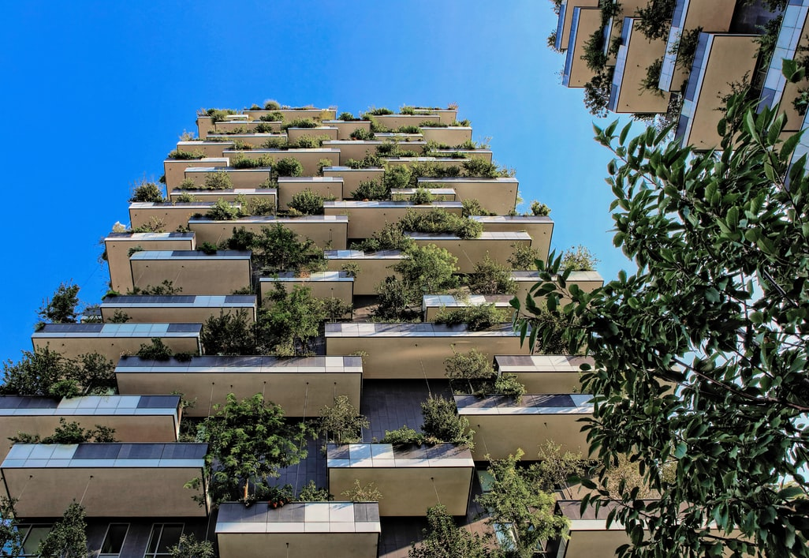
ENERGY PERFORMANCE CERTIFICATE
In order to design energy efficient homes, and make them comfortable and durable, Energy Performance Certificate (EPC) is also noteworthy. The EPC represents a speciﬁc energy policy tool to orient the building sector and real-estate markets toward higher energy efﬁciency buildings, while the foremost goal of the EPC is to generally lower the CO₂ emissions of the building sector.
Energy Performance Certificate was introduced in the European Union in 2002 to accomplish the EU’s emissions reduction goals in the building sector. EPC became widely used by England and Wales in 2007. It is a legal requirement for a building to be sold, let or constructed, and is valid for 10 years.
The certificate classifies and allocates studied buildings into A-G scale in the Energy Efficiency Rating. The most efficient homes with the lowest fuel bills are in rank ‘A’, while group ‘G’ shows the least efficient buildings. EPC can also be gained for commercial buildings and they get assigned to A-G groups as well. Importantly, before buildings are sold or let, their rating should be of at least an 'E'. Interestingly, currently the average energy efficiency rating for a dwelling in England and Whales is in band ‘D’.
However, it should be mentioned that calculation methods of energy requirements may vary from country to country, and thus national implementations of the EPC within the EU can differ considerably.
15
12

Slide 17
When a house owner decides to acquire the EPC, EPC works with accredited energy assessors who will conduct an energy assessment of the house. They will need to check every room and also inspect heating systems and controls, as well as taking measurements and photographs of the property.
The assessment shows what the current costs of the house are in terms of lighting, heating and hot water usage, explains how much could be saved in case of efficiently using energy, and what could be the potential reduced costs in these criteria. These costs exclude energy use for running appliances as TV, computer, microwave, etc. Based on acquired current points and calculations about potential future savings for the property, they allocate the building into Energy Efficiency Rating (A-G) table.
Recommendations given by EPC team about actions to be taken to make a house more energy-efficient and cost effective include, for instance, increasing wall insulation and draught proofing. These changes can significantly reduce utility bills, and hence the teams’ expertise is highly valuable. A higher rating is attractive to potential buyers when selling a building in a competitive market and gives an advantage over similar properties in the area.
The sample energy efficiency rating form is given below, which shows current energy efficiency of a given home, while the potential rating shows the c of following the recommendations.
Energy Efficiency Rating
Very energy efficient – lower running costs
Current
Potential
(92 plus)
A
(81-91)
B
(69-80)
C
68
74
(55-68)
D
(39-54)
E
(21-38)
(1-20)
16

Slide 18

Benefits and Incentives
It is notable that financial implications of owning a house of a certain energy class is still quite uncertain. However, European Commission reported that according to the analysis of 10 cities, EPCs had an insignificant but still positive effects on housing prices. One level improvement in the energy class (e.g., moving from D to C, or from C to B) increased the property value by 0.5-10.5%.
Furthermore, Hyland et al (2013) based on the Irish property market suggested that EPC label brings positive changes for a building in terms of both rent and sale prices. For example, compared to a property in ‘D’ rating, the price premium for a building in ‘A’ rating is 11% and for ‘B’ rating is 5.8%. Whereas, ‘F’ or ‘G’ ratings seem to reduce property value by 5.6%.
17

Slide 19
Moreover, there are different public programs that aim to increase the energy efficiency of residential properties. For example, “Energy Saving at Home” is a program in Greece since 2011 that targets buildings in an energy rating of ‘D’ or lower. After identifying inefficient properties, they offer financial support in form of grants or interest free loans. Necessary energy interventions are advised and verified by accredited energy experts and are supported by several inspections. Similar programs exist in France, Portugal and Austria too. In the latter the program covers up to 30 % of investment costs up to 7,000 euro and fully covers (up to 300 euro) the expenses of an EPC.
18

Slide 20


Slide 21
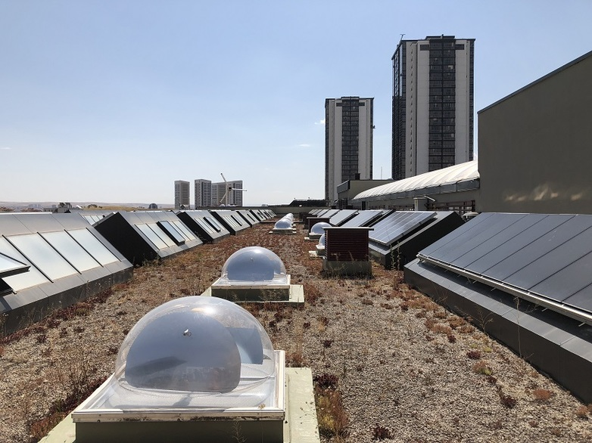
EMPIRICAL STUDY
Location: Germany
A study by Amecke (2011), investigating 662 individuals in Germany who have purchased a dwelling since 2009 when the EPC became mandatory for residential buildings, shows that the respondents indicated a high awareness of the EPC. 81% of respondents stated that they knew of the certificate. Meanwhile 77.8% indicated that they used the certificate during their search process to ensure that they chose an energy-efficient house, and 34.7% stated that they checked the certificate for a favorite dwelling.
The survey also aimed to elicit the level of trust attributed to the information provided by the EPC. Respondents rated the trustworthiness of the EPC as 4 out of 7. The respondents also underlined the usefulness of EPC, indicating energy efficiency of a property, due to their interest in a) running costs, b) environmental protection, c) resale value, and d) comfort of dwelling. In a nut shell, respondents indicated that the EPC played some role in their purchasing decision.
20

Slide 22


Slide 23
Looking Ahead:
Having reviewed the importance of sustainability and green buildings, and the most popular third-party certification systems validating green buildings, we will be touching upon greenness trends in Georgia and sustainability of real estate in the country in our upcoming article.
22

Slide 24
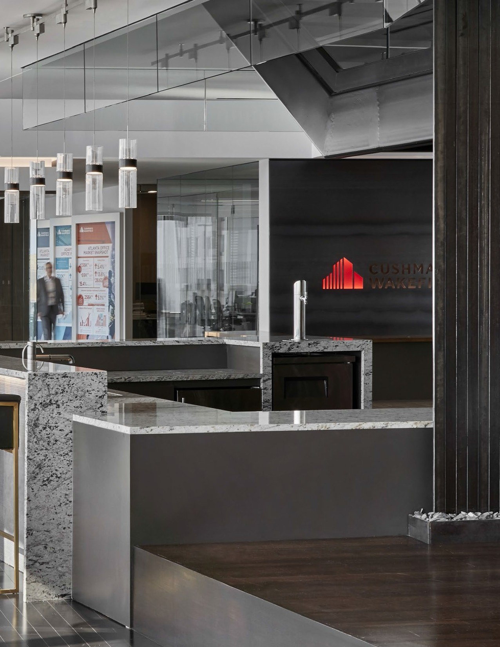

For more information
Tekla Iashagashvili | Head of Strategic Advisory and Research
+995 322 474 849
tekla.iashagashvili@cushwake.ge
Tamta Janiashvili | Research Analyst
+995 558 018 811
tamta.janiashvili@cushwake.ge
Gvantsa Potskhveria | PR and Marketing Manager
+995 599 014 444
gvantsa.potskhveria@cushwake.ge
cushwake.ge
Veritas Brown LLC is a third-party non-owned affiliate of Cushman & Wakefield (C&W), licensed by C&W to use the Cushman & Wakefield brand and trademarks. Accordingly, this engagement is with Veritas Brown and not with any member of the Cushman & Wakefield group of companies. Whilst Veritas Brown carries out real estate services in accordance with C&W's best practice guidelines, Veritas Brown's work in carrying out this engagement will be undertaken independently of C&W and accordingly, C&W accepts no responsibility for the services provided by Veritas Brown, which are not underwritten or guaranteed by C&W

